Slide 1

Task 2 Predicting customer buying behaviour
Build a predictive model to understand factors that influence buying behaviour
By
Pransshu G

Slide 2
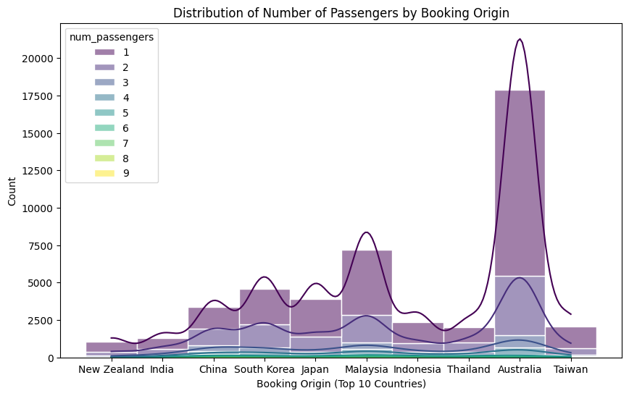
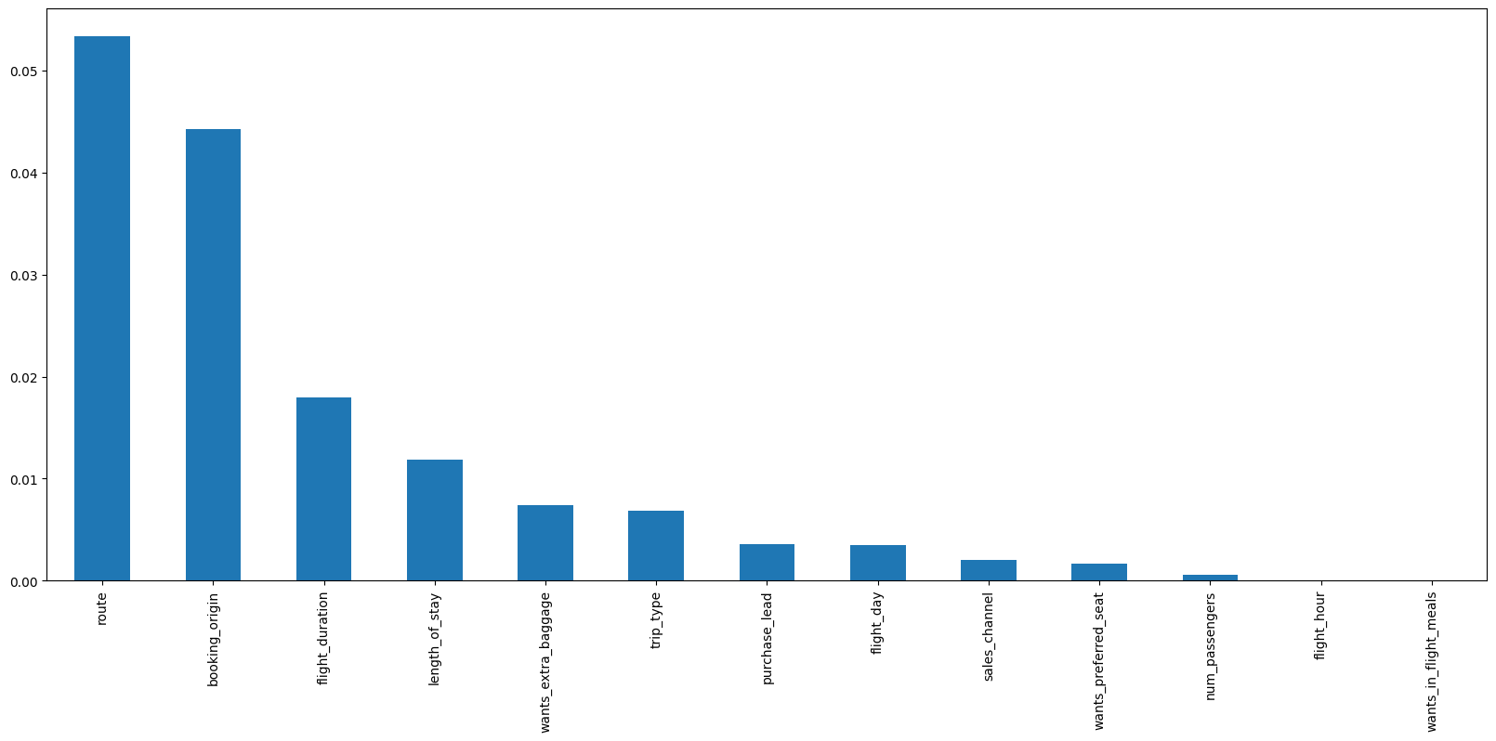
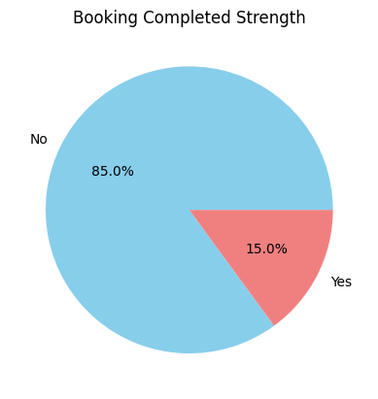
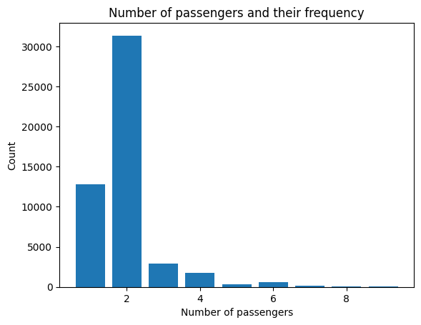
Insights
Top 5 Important Features: Route
Booking Origin Country
Duration of Flight Journey
Length of Stay
Wants Extra Baggage facility
ACCURACY OF THE MODEL: 0.8496
AUC Score: 0.54

